Slide 1
Hungry Hustle Security Analysis Report
Presented by Benjamin Rutt
October 14, 2024

Slide 2
Dashboard Overview
Purpose of the security analysis
Objectives: Identify vulnerabilities, investigate suspicious activities, recommend strategies
Tools used: Splunk for log analysis and dashboard creation
Overview of the presentation structure

Slide 3
Security Monitoring Dashboard
Real-time monitoring of security metrics
Key components:
Total Unauthorized Access Attempts
Top 10 IPs Attempting Unauthorized Access
Suspicious User Sessions
Potential DDoS Attacks

Slide 4
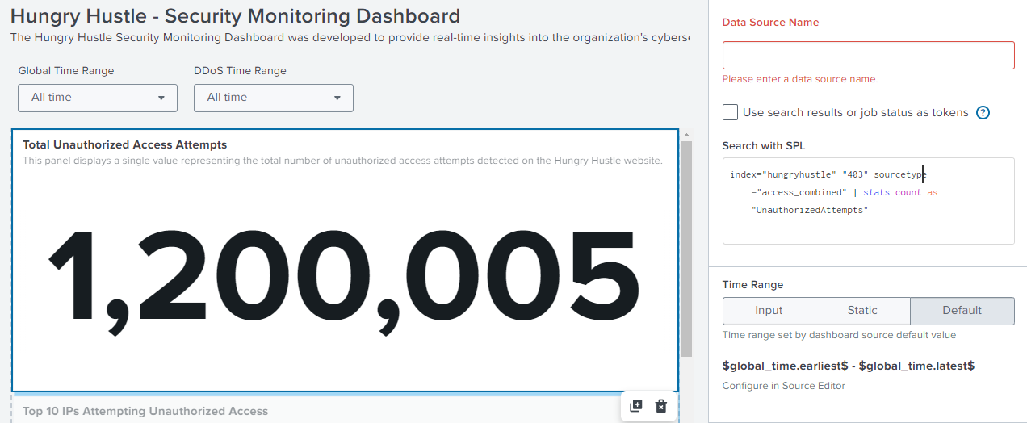
Total Unauthorized Access Attempts

Slide 5
Total Unauthorised Access Attempts
Definition: Attempts to access restricted areas (HTTP 403 errors)
Splunk Query Used:
index="hungryhustle" "403" sourcetype="access_combined" | stats count as UnauthorisedAttempts
Result: Total count displayed on the dashboard
Importance: Indicates overall threat level

Slide 6
Top 10 IP Addresses
Purpose: Identify and block malicious sources
Splunk Query Used:
index="hungryhustle" "403" sourcetype="access_combined“
| stats count by clientip | sort -count | head 10
Outcome: List of top offending IPs
Action: Blocking or monitoring these IPs

Slide 7
Geographic Origins of Attacks
Analysis of attack origins
Splunk Query Used:
Findings: Most attempts fom USA, China, Japan
Implications: Consider geo-fencing and targeted monitoring

Slide 8
Unauthorized SSH Key Transmission
1. Incident involving Sam Muller’s machine
Splunk Queries Used:
Identify Sam’s machine:
index="hungryhustle" "sam_muller@hungryhustle.website"
2. Filter suspicious activities:
index="hungryhustle" "ip-192-168-1-25.ec2.internal" NOT "sam_muller@hungryhustle.website@localhost"
Discovery: Email sent with SSH key attachment to external recipient
Action Taken: Revoked access, secured systems

Slide 9
Workplace Conflict Between Steve and Rick
Allegations of unprofessional behavior by Rick towards Steve
Splunk Query Used:
index="hungryhustle" ("steve" AND "rick") NOT ("steve@hungryhustle.website" OR "rick@hungryhustle.website")
Findings: Email mocking Steve’s finances sent to external address
Outcome: Information handed over to HR

Slide 10
Detecting the XSS Attack
Description of XSS attack
Splunk Query Used:
index="hungryhustle" ("<script>" OR "javascript:" OR "alert(")
Discovery: Malicious script injected into URL parameters
Action Taken: Patched vulnerability, enhanced input validation

Slide 11
DDoS Attack Investigation
Date of incident: May 19, 2024
Splunk Queries Used:
Initial traffic analysis:
index="hungryhustle" earliest="05/19/2024:09:00:00" latest="05/19/2024:10:00:00" "GET"
Counting unique IPs:
index="hungryhustle" "GET" | stats dc(clientip) as unique_ips
Findings: 50,559 unique IPs causing traffic spike
Implications: Overwhelmed server leading to outage
Mitigation: Implemented DDoS protection measures

Slide 12
Monitoring Employee Activity
Investigation into Rick’s performance decline
Splunk Query Used:
index="hungryhustle" source_ip="192.168.0.8" destination_ip="208.65.153.238"
Discovery: Over 100,000 connections to YouTube
Action Taken: Addressed misuse of company resources

Slide 13
Most Visited Food Item
Analysis of web logs to identify popular products
Splunk Query Used:
index="hungryhustle" "GET" uri="/src/assets/products/" | stats count by uri | sort -count
Outcome: "Hustle Kebab" with 100,000 visits
Implications: Focus marketing and inventory on popular items

Slide 14

Strengthening Cybersecurity
Continuous Monitoring
Implement advanced SIEM solutions
Configure automated alerts
Proactive Vulnerability Management
Regular security assessments and patch management
Secure coding practices
Data Loss Prevention (DLP)
Encrypt sensitive data
Enforce access control policies
Employee Training and Awareness
Regular cybersecurity training programs
Clear communication of acceptable use policies
Incident Response Planning
Develop and test incident response plans
Form dedicated response teams
Collaboration and Threat Intelligence Sharing
Join industry cybersecurity groups
Subscribe to threat intelligence feeds
Implementing Geo-Fencing and Access Controls
Restrict access from high-risk regions
Enforce Multi-Factor Authentication (MFA)

Slide 15
Securing Our Future
Summary of key findings and actions taken
Importance of implementing recommended strategies
Commitment to continuous improvement in cybersecurity
Open floor for questions

